Slide 1

Image classification
Comparing Optimal Transport-based and Traditional Manifold Learning Algorithms

Slide 2
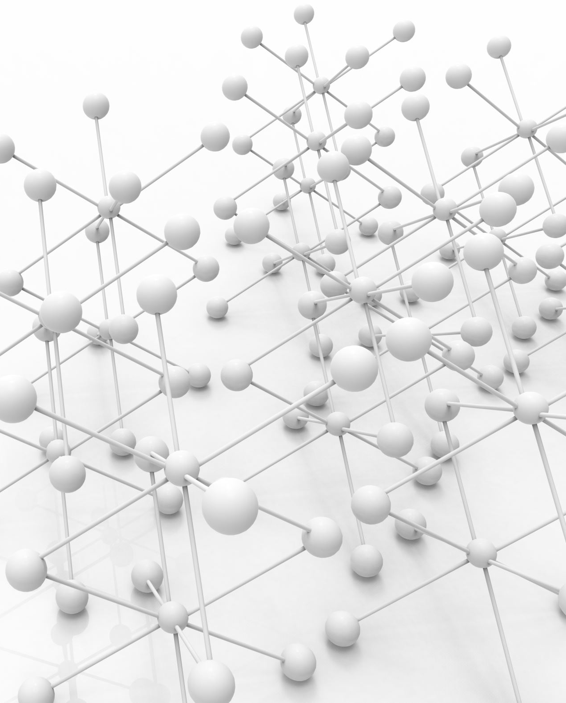
Manifold Learning
Manifold learning uncovers low-dimensional structures hidden in high-dimensional data, ideal for complex datasets where direct analysis is impractical.
It preserves crucial geometric relationships, essential for tasks like visualization and feature extraction, enhancing the performance of supervised learning by simplifying data complexity.

Slide 3

FASHION MNIST

Slide 4
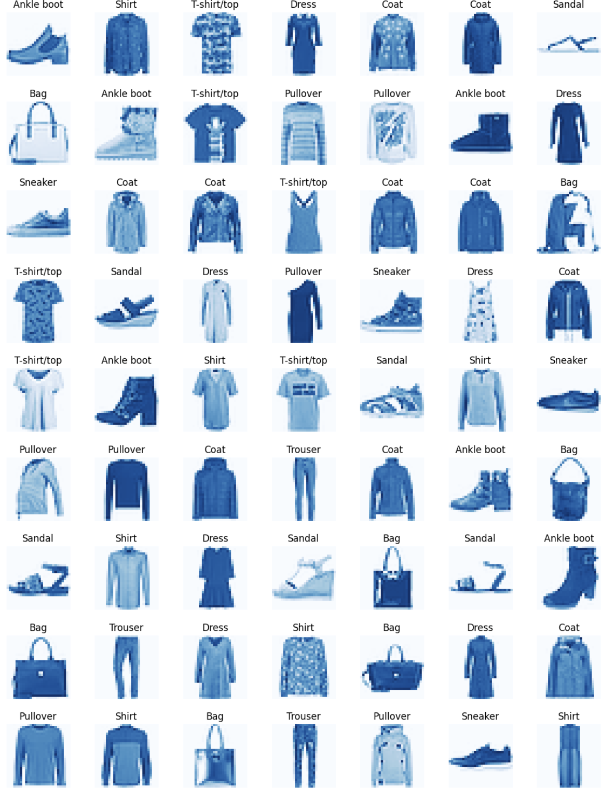
Dataset
Images of clothing items (
Array (typically used with libraries like TensorFlow and Keras).
28x28 grayscale images.
Data points of 70,000 images (60,000 for training and 10,000 for testing).
There are 10 classes.
Type of classes is a label (such as "T-shirt/top", "Trouser", "Pullover", etc.).
Data points in each classes:
7,000 images per class (6,000 for training and 1,000 for testing).

Slide 5
Data Preprocessing
None required.
The dataset is already preprocessed for convenience.
Images are normalized to have pixel values between 0 and 1 when used in most deep learning frameworks.

Slide 6
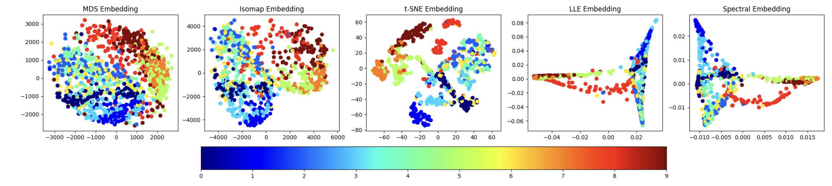
Euclidean Embeddings

Slide 7
Classification task:
LDA: Linear Discriminant Analysis
KNN: K-Neighbors (k=1,3,5)
SVM: Linear and RBF
Random Forest
Multinomial Logistic Regression
n_components =10
n_components = 100

Slide 8
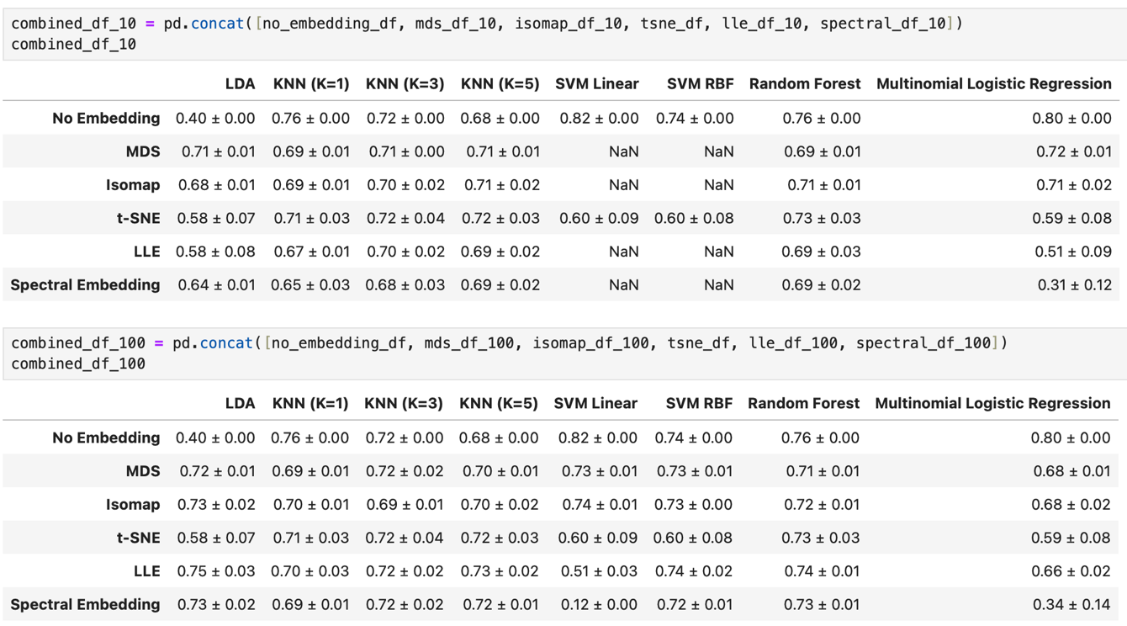
Accuracy score of Euclidean Embedings
For the sample size of n=1000

Slide 9

T-test conduct
Compare the mean accuracy scores of various embedding techniques against no embedding performance.
To determine if these techniques statistically improve the classification accuracy

Slide 10
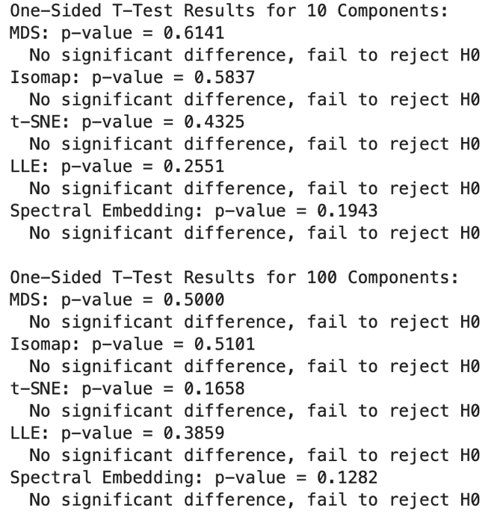
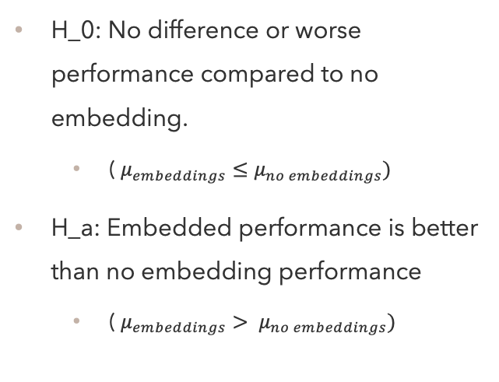
T-test Performance
H_0: No difference or worse performance compared to no embedding.
( $μ_{embeddings}≤μ_{no embeddings})$
H_a: Embedded performance is better than no embedding performance
( $μ_{embeddings}> μ_{no embeddings})$
Compare the p-value to alpha=0.05

Slide 11
Wassmap embeddings
Preprocessing Steps:
Image Conversion:
Apply the Dr. Hamm function to transform each image into a point cloud representation.
Sampling:
Select a sample size of n = 1000-1500 from the MNIST dataset.
Choose 5-10 images from each class within the Dog Breed and Coil-100 datasets to create a comprehensive sample set in point cloud format.
Embedding Techniques:
Utilize the Wasserstein distance-based translation as a foundation for embedding.
Implement a variety of embedding techniques, including:
Multidimensional Scaling (MDS)
Isometric Mapping (Iso-map)
t-Distributed Stochastic Neighbor Embedding (t-SNE)
Locally Linear Embedding (LLE)
Spectral Embedding

Slide 12
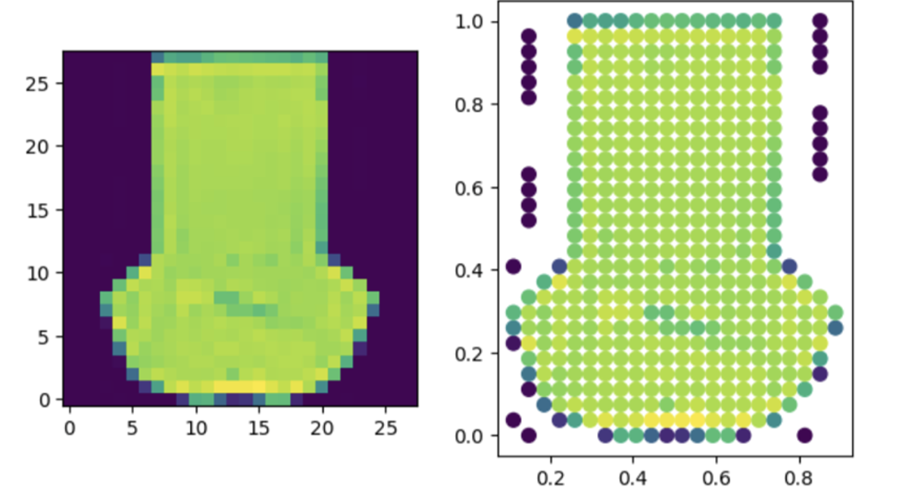
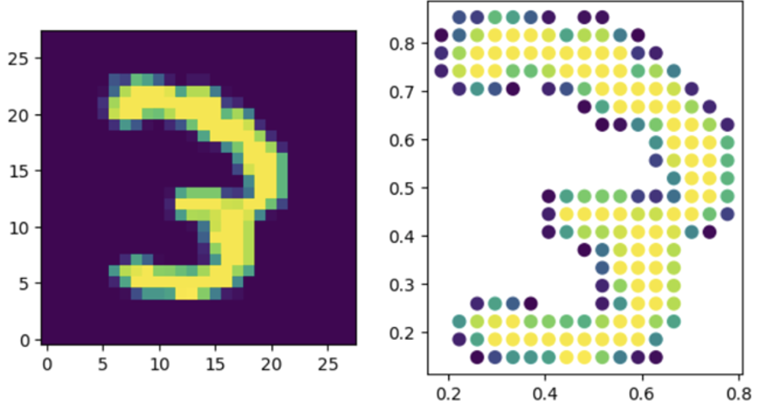
Point Cloud
Converted all images into point cloud representations using Dr. Hamm's point cloud function, and then applied Wasserstein distance-based embeddings to enhance classification accuracy

Slide 13
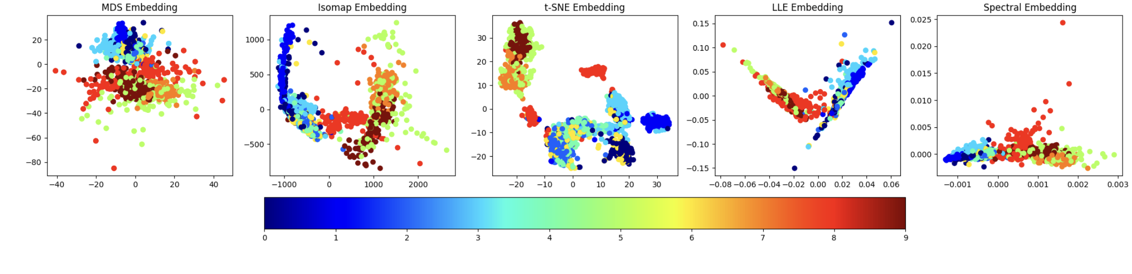
Wassmap embeddings

Slide 14
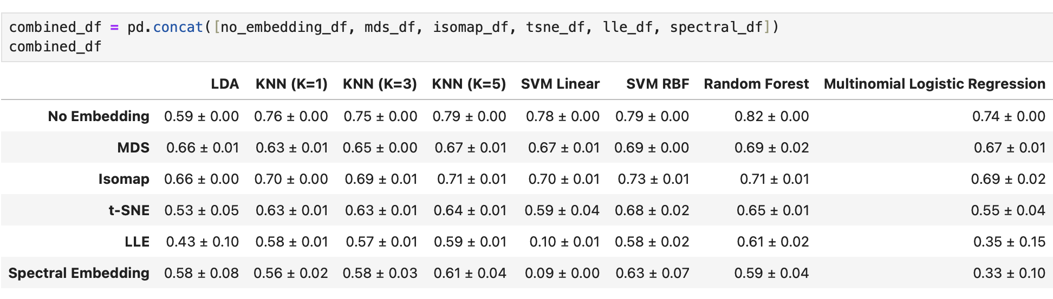
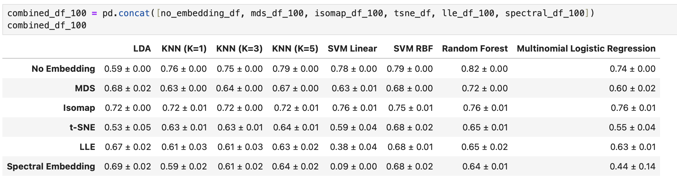
Accuracy score for Wassmap

Slide 15
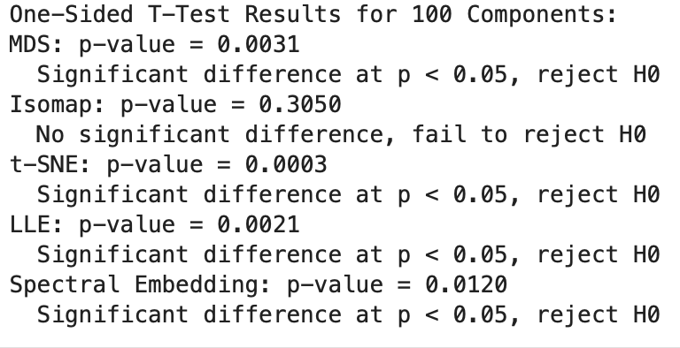
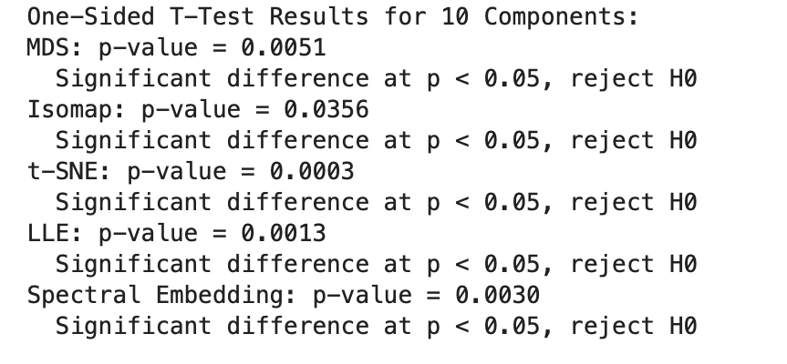
T-test performance

Slide 16
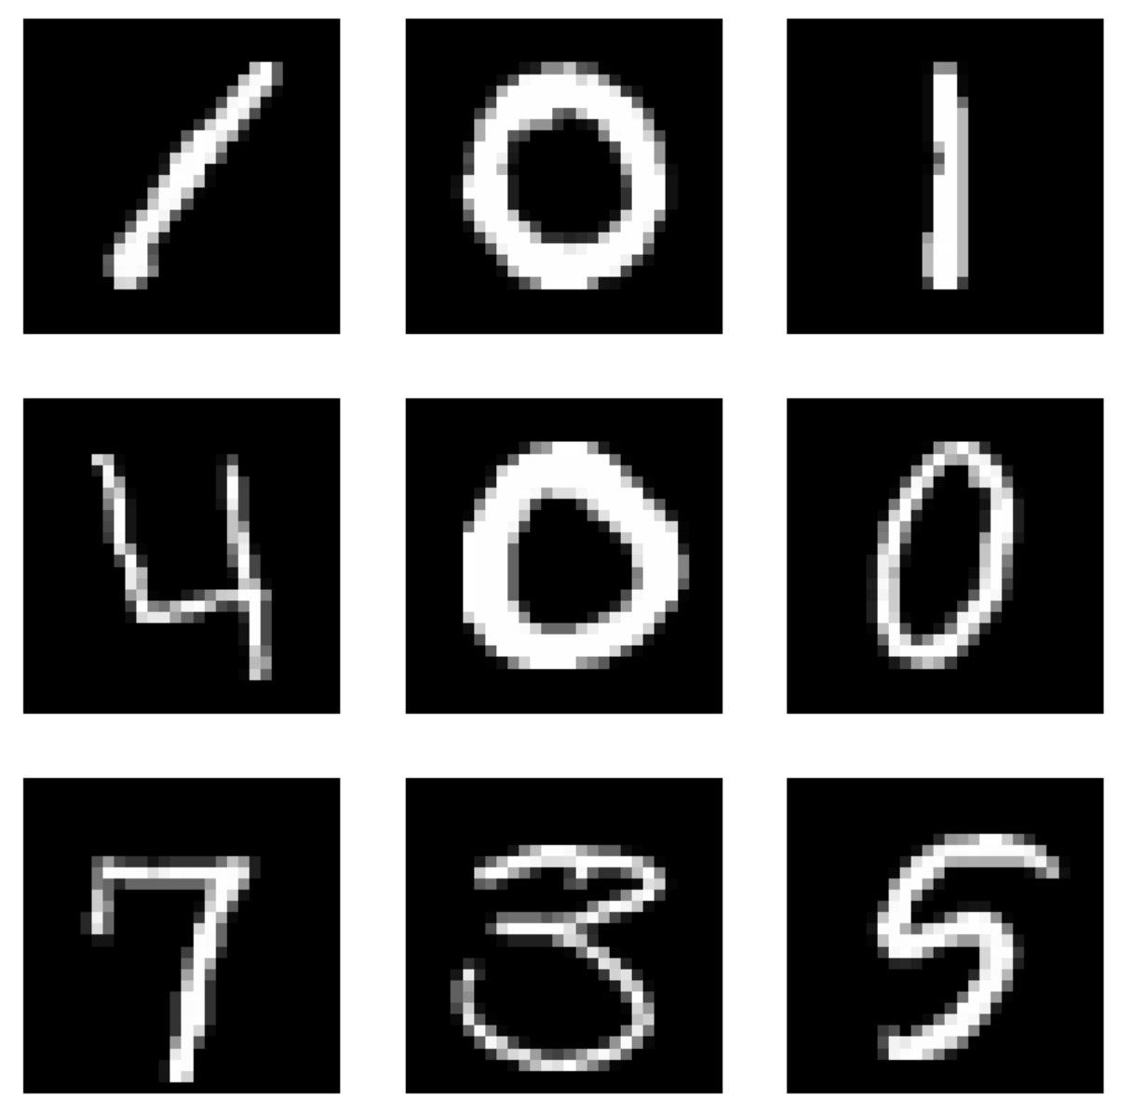
Digital-Handwritten-MNIST

Slide 17
Dataset
Handwritten digit images.
Format: Grayscale images, typically in array format.
Uniform 28x28 pixels.
Total Data Points: 70,000 images (60,000 for training, 10,000 for testing).
10 classes (digits 0 through 9).
Type of Classes: Numerical labels representing the digit value.
Points per Class: Approximately 7,000 images per class.

Slide 18

Data processing
None required
Data already converted to grayscale images also the size of 28x28
Pixel values scaled from 0-255 to 0-1 to aid in learning process.
Images converted from 2D array (28x28) to 1D array (784) for certain algorithms.

Slide 19
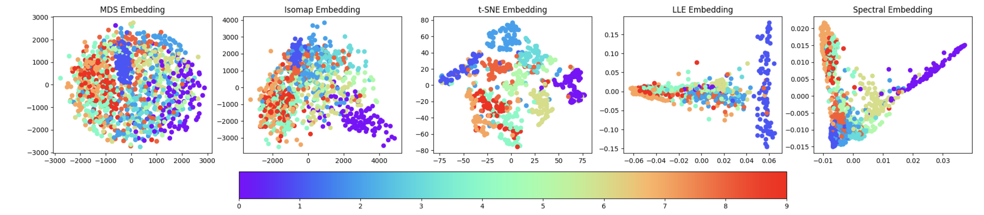
Euclidean Embeddings

Slide 20
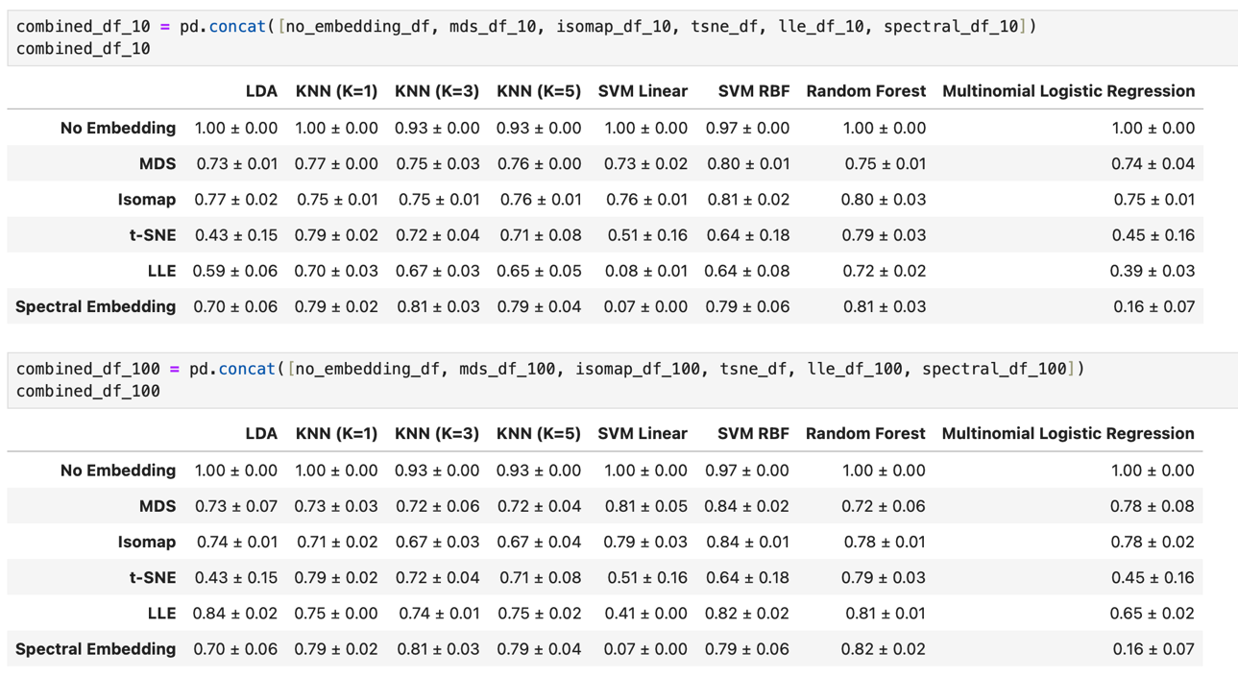
Accuracy Score Euclidean Embeddings

Slide 21
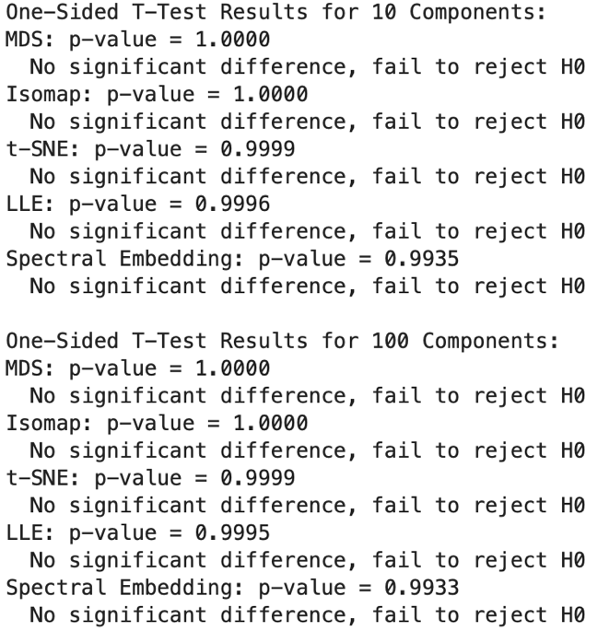
T-test Performance

Slide 22
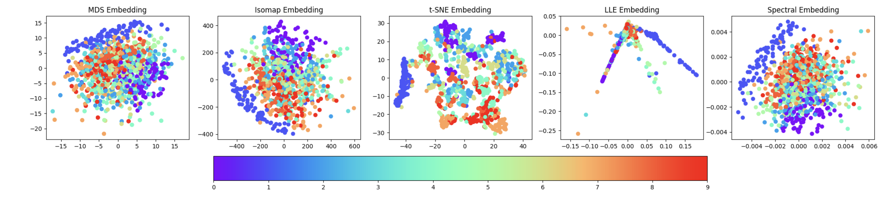
Wassmap embeddings

Slide 23
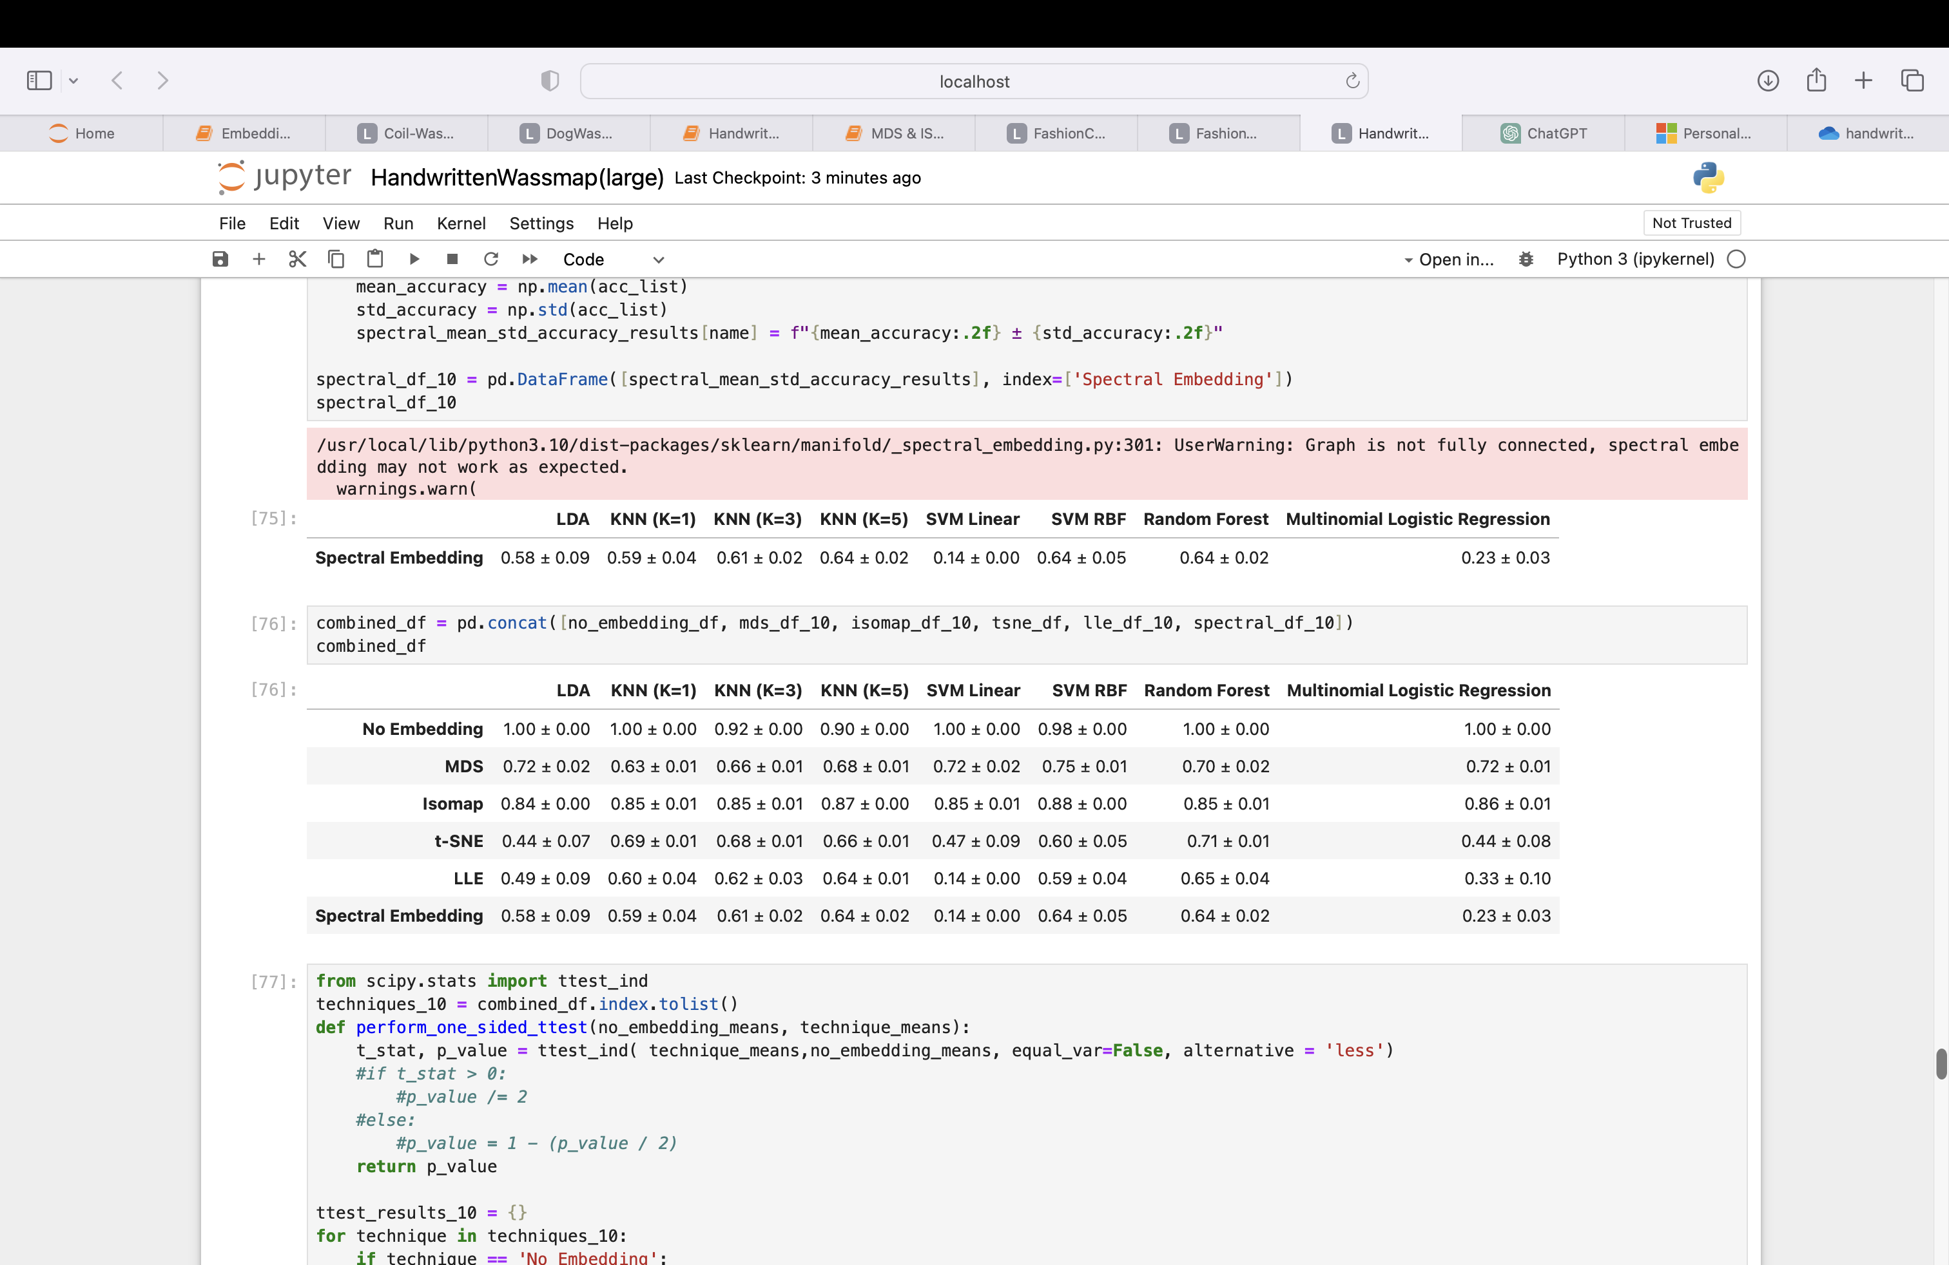
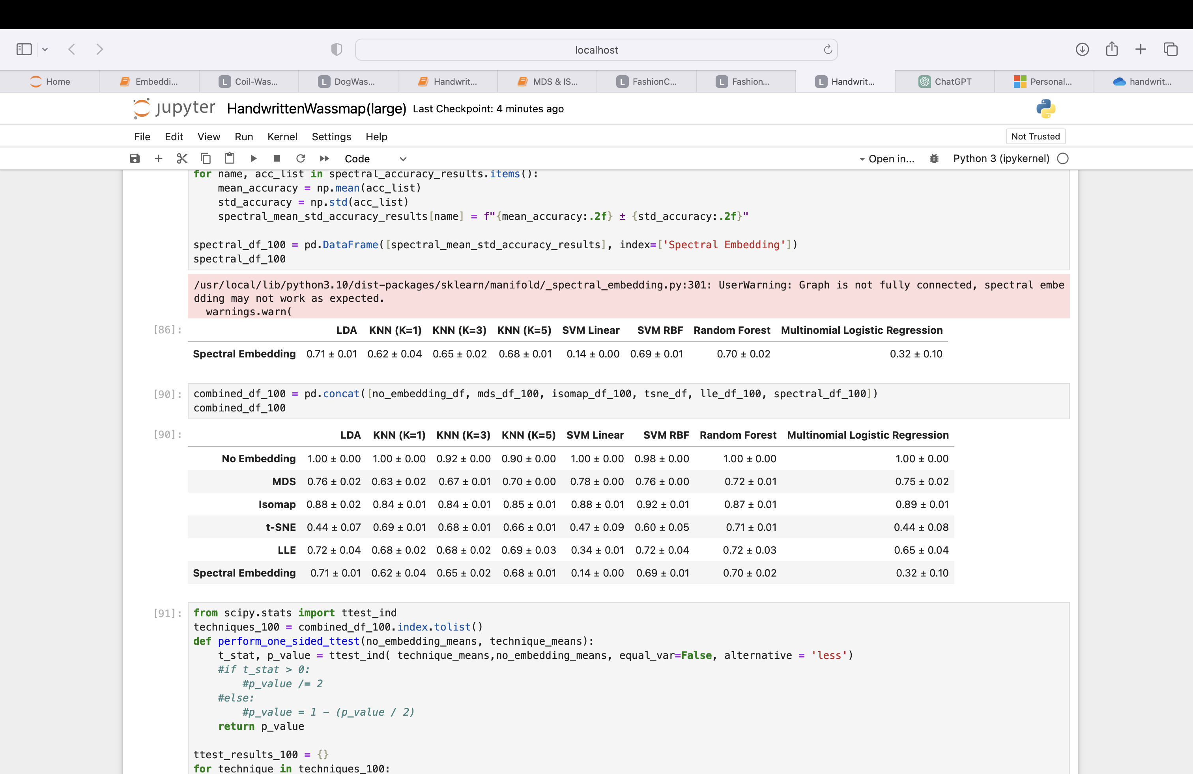
Accuracy Score

Slide 24
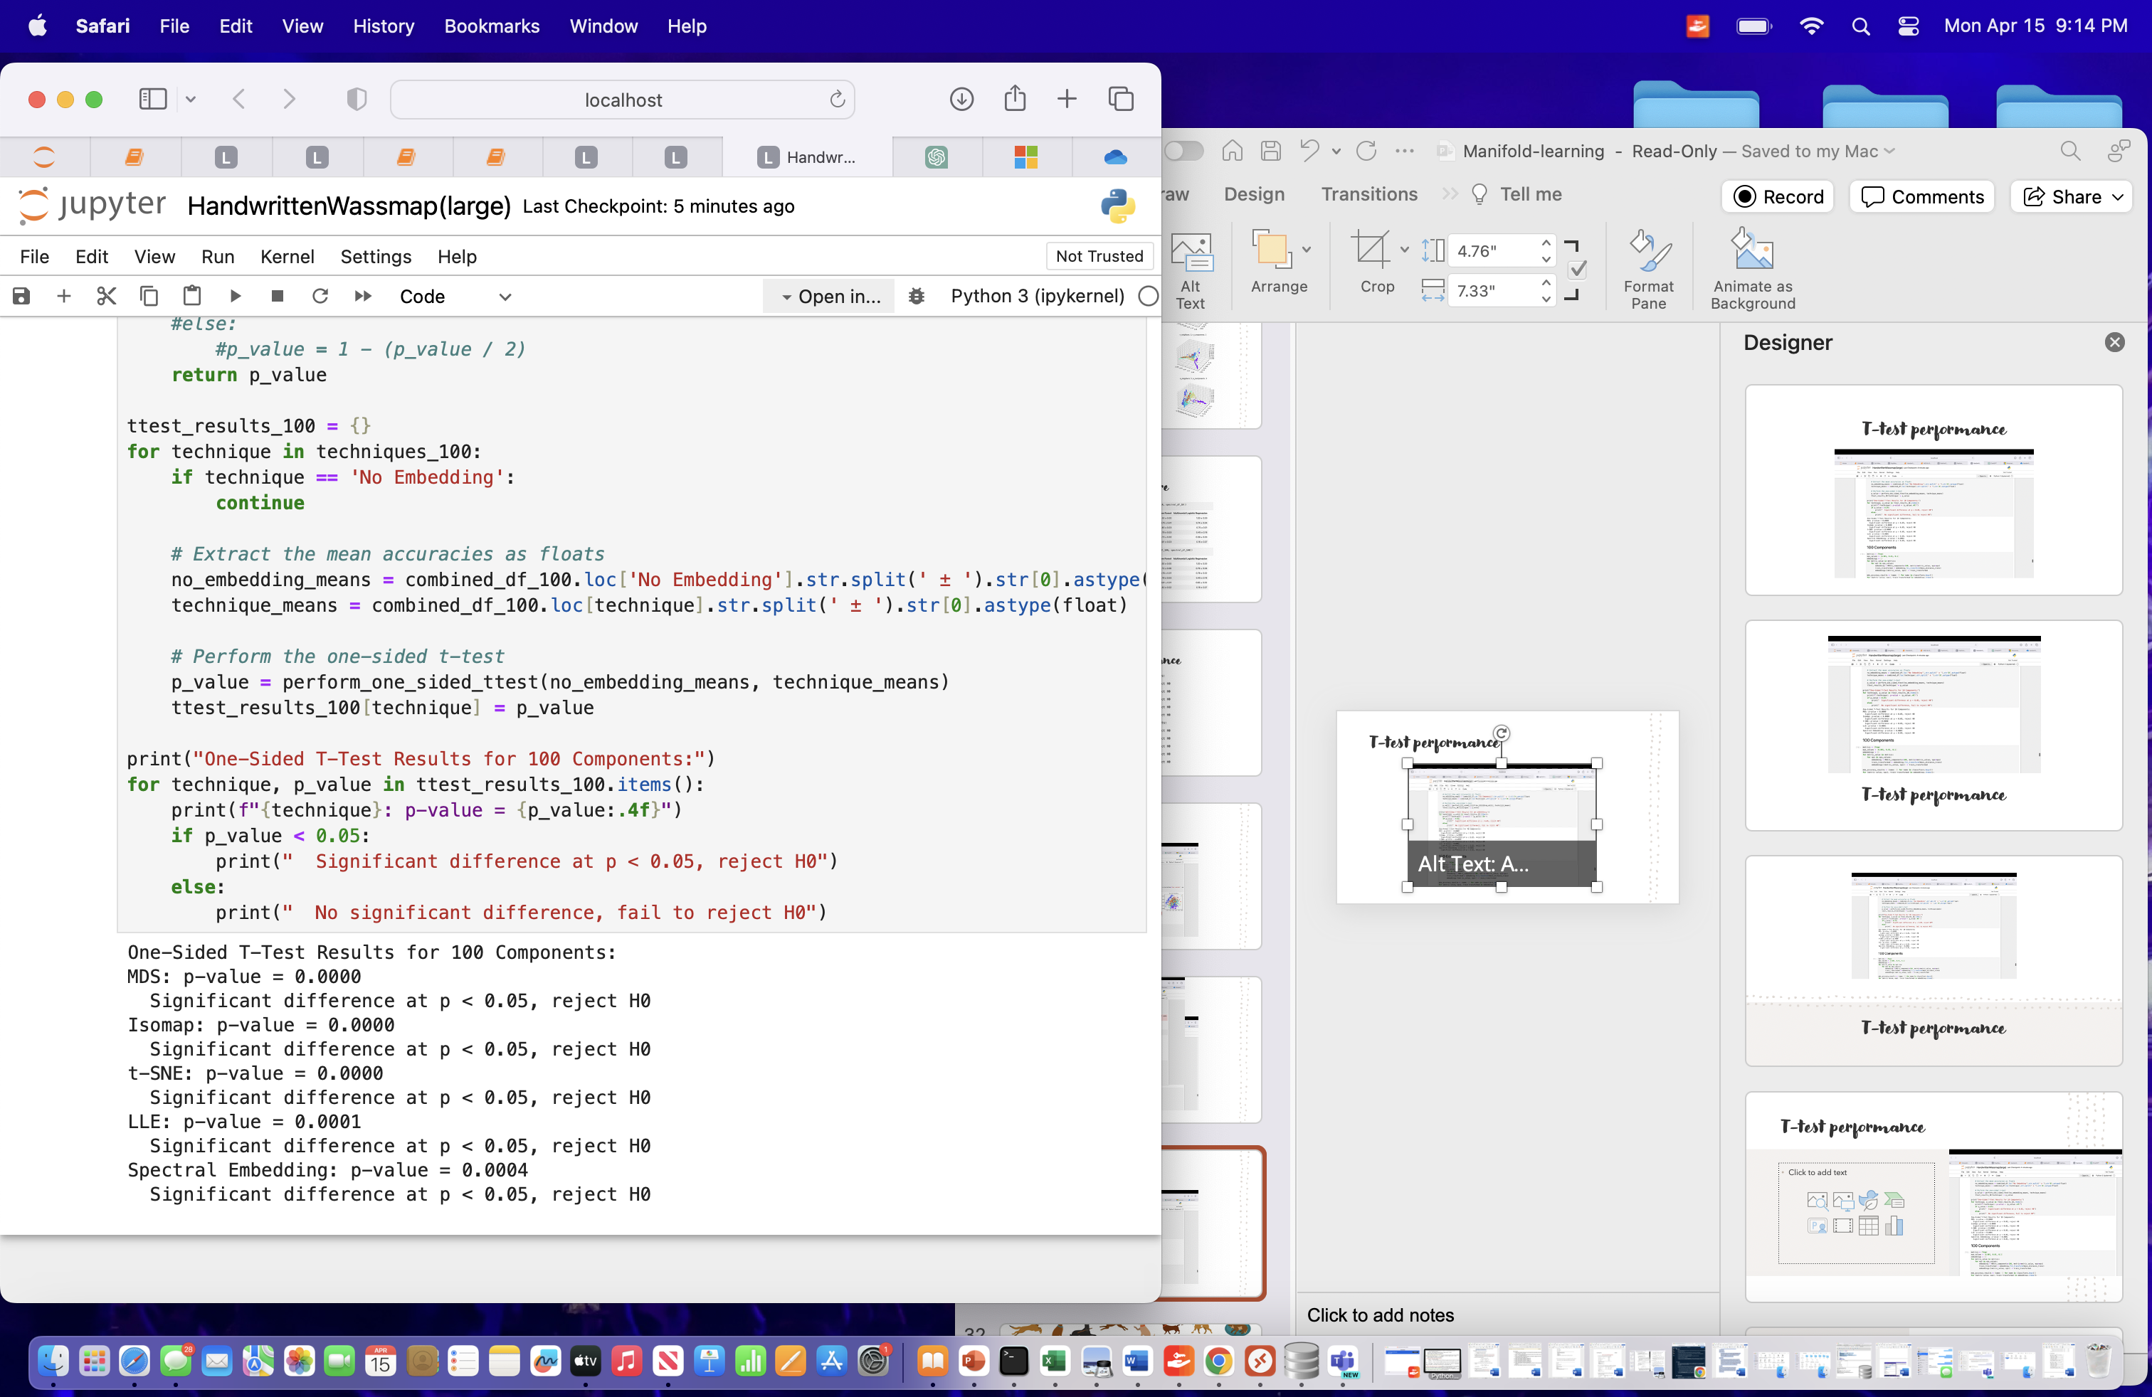

T-test performance

Slide 25

DOG BREED CLASSIFICATION Dataset

Slide 26
Dataset
The data consists of images segmented into various dog breed folders.
The images are in ‘.jpg’ format.
There are total of 541 images across all classes and distinct into 8 dog breed classes in dataset. Each class is label representing a specific dog breed.
Data points in each class:
Rottweiler: 78 images
Dalmatian: 51 images
German-Shepherd: 76 images
Beagle: 83 images
Husky: 71 images
Poodle: 56 images
Bulldog: 76 images
Labrador-Retriever: 50 images

Slide 27
Data preprocessing
All images had different size before processing.
The image were converted to grayscale and resized to a uniform size of 224x224*(average size). This processing is commonly done to standardize the input for deep learning models and to simplify computations. The requirement is should be the same dimension.
Various manifold learning techniques were applied, such as MDS, ISOmap, t-SNE, Locally Linear Embedding, and Spectral Embedding.
Notes:
This processing is commonly done to standardize the input for deep learning models and to simplify computations.
These techniques are used to visualize and explore the high dimensional data in lower-dimensional spaces, which can aid in understanding the relationships between different data points or classes

Slide 28
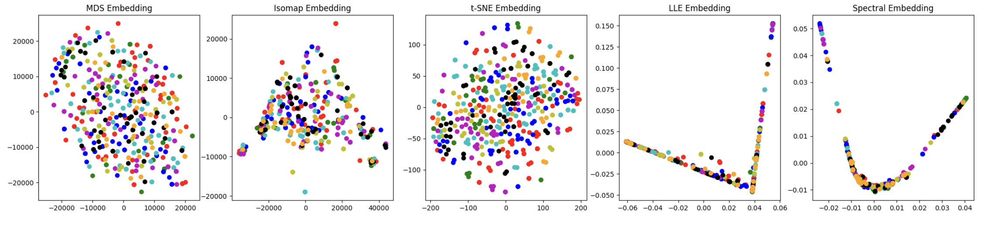
Euclidean Embeddings

Slide 29
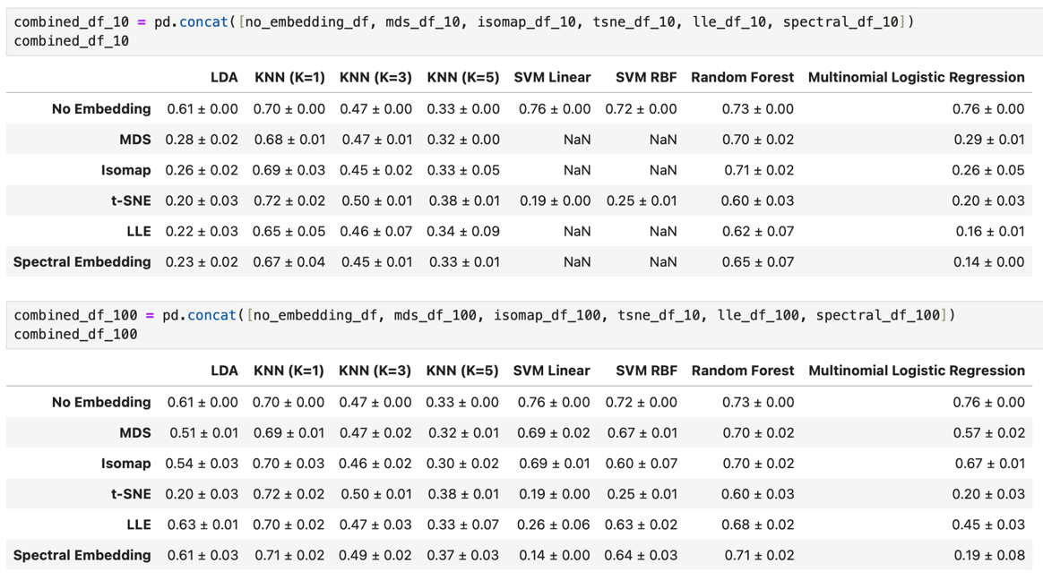
Accuracy Score of Euclidean

Slide 30
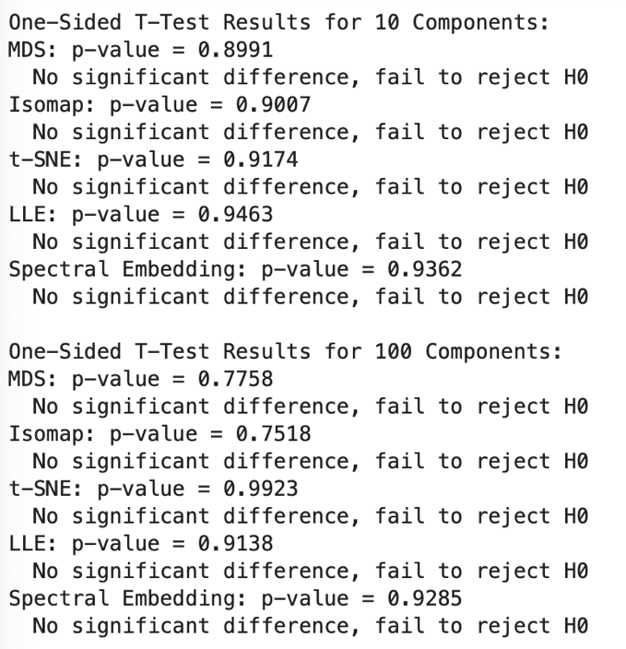
T-test performance

Slide 31
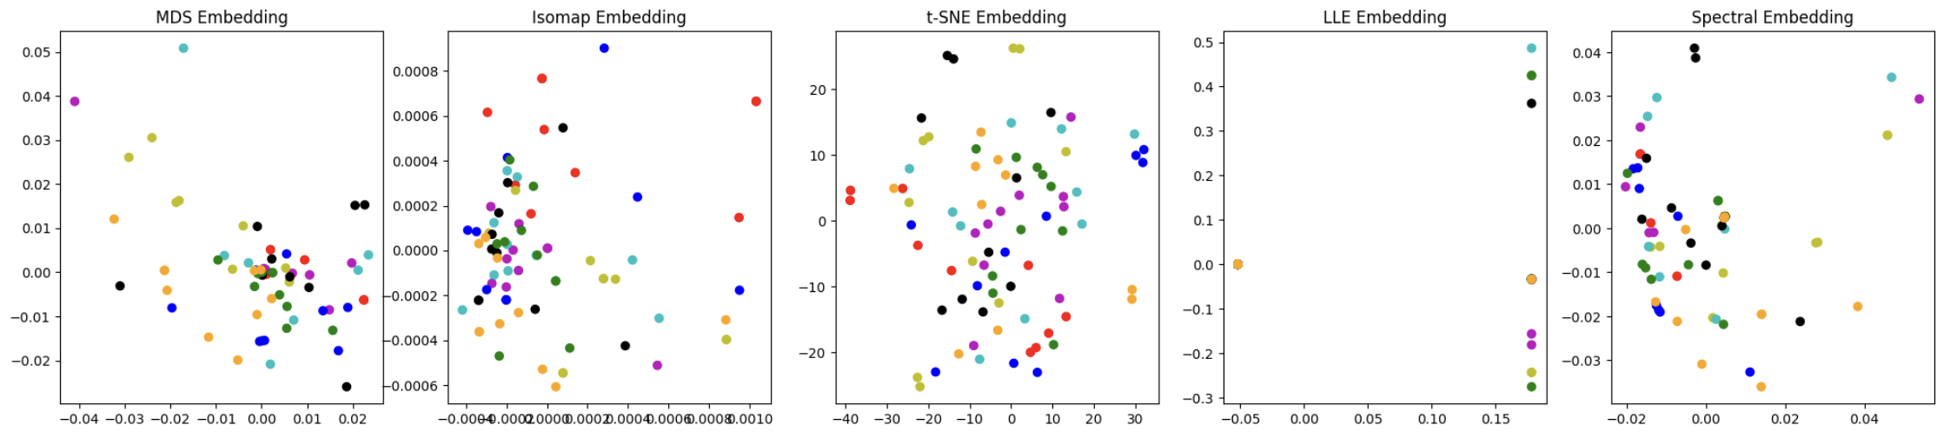
Wassmap Embeddings

Slide 32
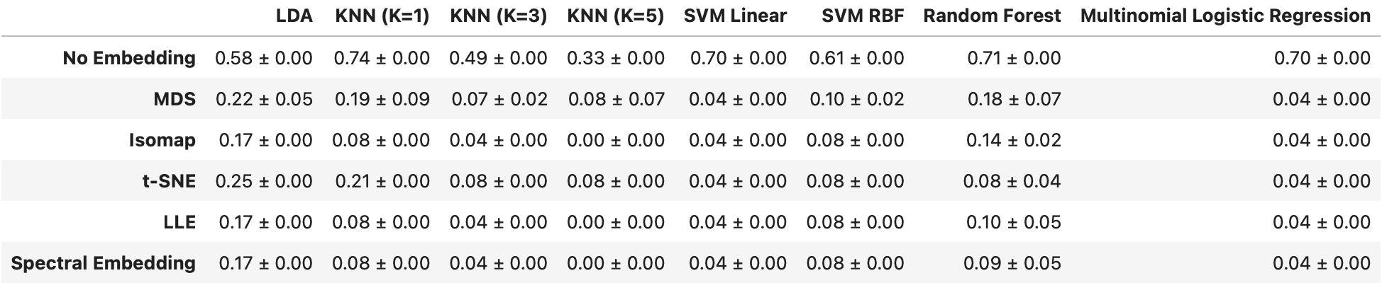
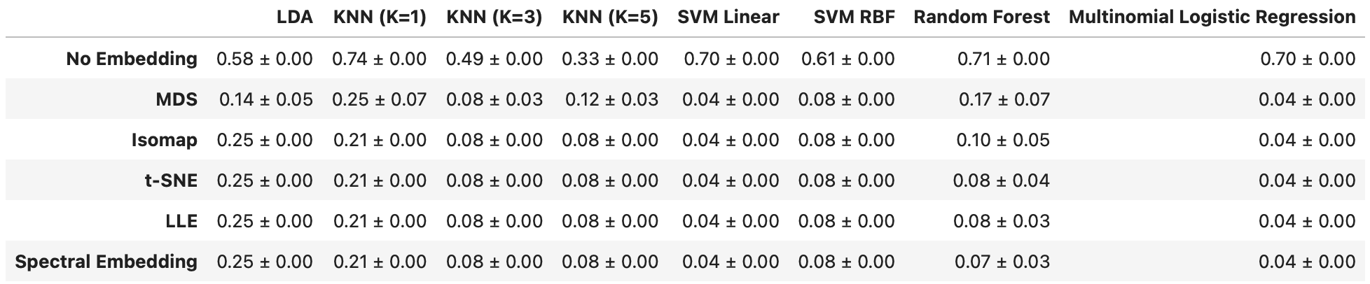
Accuracy Score of Wassmap

Slide 33
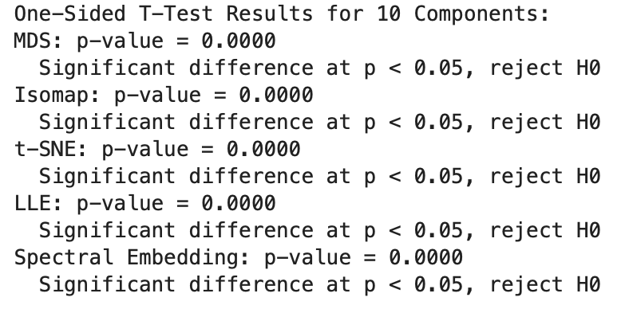
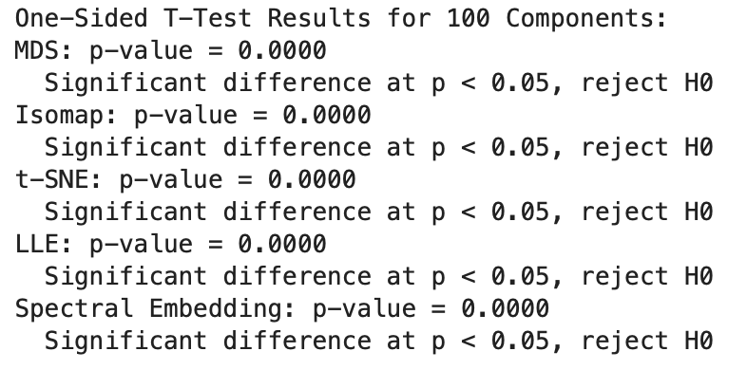
T-test Performance

Slide 34
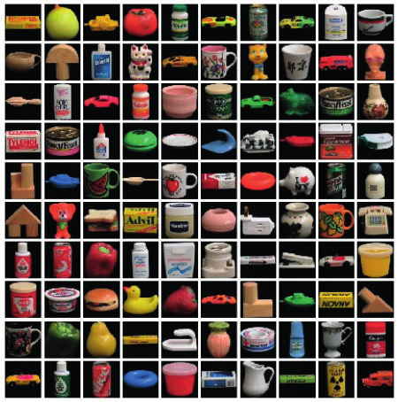
Coil-100

Slide 35
Dataset
Data Description:
Nature: Images of 100 different objects taken at various angles.
Format: Color images, typically stored as arrays.
Resolution: Originally varied; resized to 224x224 pixels.
Dataset Composition:
Total Data Points: 7,200 images (72 images per object).
Number of Classes: 100 (each class corresponds to an object).
Type of Classes: Object labels by number.
Points per Class: 72 images per object.

Slide 36
Data processing
Grouping: Organized images by object number for labeling.
Conversion to Grayscale: Simplified the data by removing color information, reducing computational complexity.
Resizing: Standardized image size to 224x224 for uniformity across the dataset, necessary for many machine learning models.

Slide 37
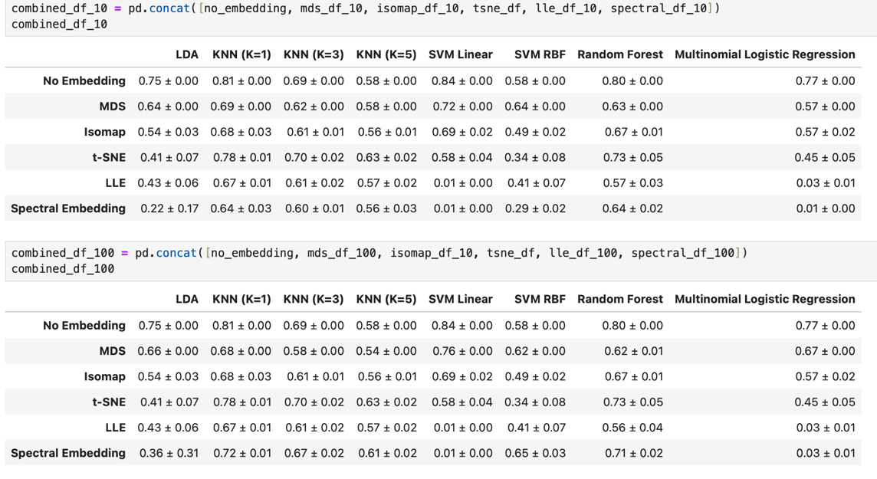
Accuracy Score

Slide 38
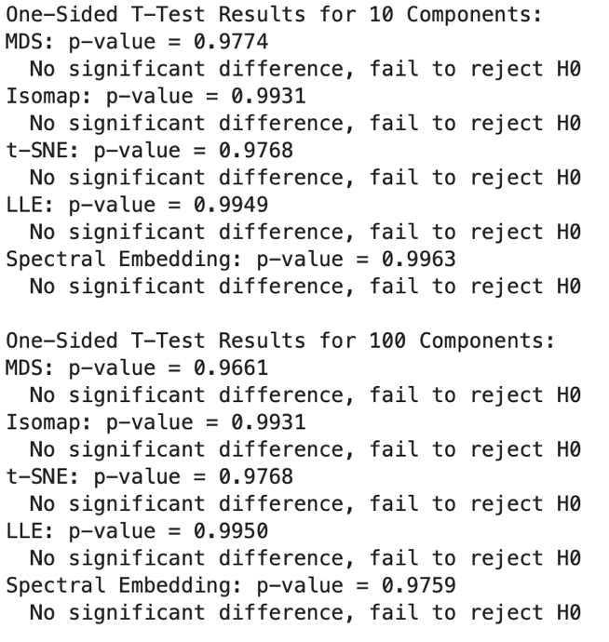
T-test performance

Slide 39
Challenge and Problem Solving
The conversion of large (224x224) images into point clouds for computing Wasserstein distances took several days to complete. While the performance did not match that of the MNIST datasets, it was still effective for the t-test analysis.
We attempted to reduce processing times by implementing cupy code, but encountered out-of-memory issues on our server because of CUDA. We are looking forward to resolving these challenges so that we can utilize larger sample sizes to enhance the effectiveness of our results

Slide 40
Conclusion:
The one-sided t-test confirms that the embedding methods statistically enhance classification accuracy, allowing us to reject the null hypothesis and affirm that these techniques improve performance.
Furthermore, Wassmap embeddings demonstrate superior clustering, show more consistency, support the effectiveness of techniques across similar dataset, evidenced by higher classification accuracy and more effective visualizations.

Slide 41
Future work: Enhanced Statical Validation
Finish the Wassmap embeddings on Coil-100 dataset
Conduct Multiple Trials on Classification method across all embeddings techniques.
Statistical Testing on Multiple Trials.
Perform the t-test to compare Wassmap embeddings directly against to Euclidean Embeddings using the data from the trials.

